Slide 1
JavaScript Functions
Hy-Tech Club: Web 201

Slide 2
Agenda
Defining Functions
Calling Functions
Callbacks

Slide 3
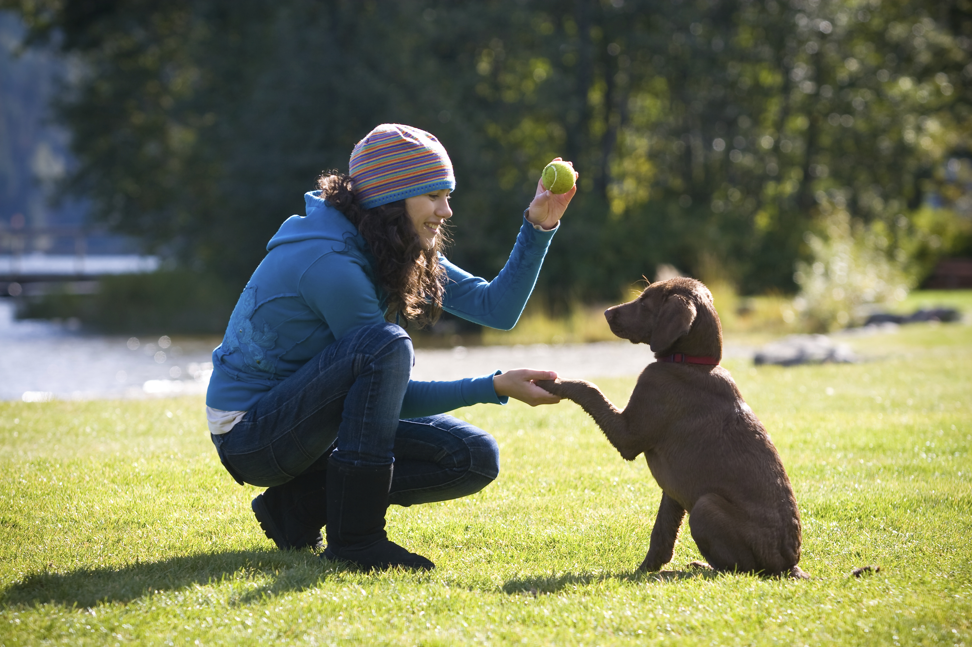
Defining a function
Notes:
Defining a function is like teaching your dog a trick (if your dog was a genius). It’s like saying “when I say fetch, you should find the ball, grab it, and return it to me.”

Slide 4
Defining a Function – In Code
function sayNumbers(num) {
x = num + 1;
console.log(x);
x = x + 10;
console.log(x);
}
Function keyword
Function name
Parentheses
Parameter
Curly brackets
Body

Slide 5
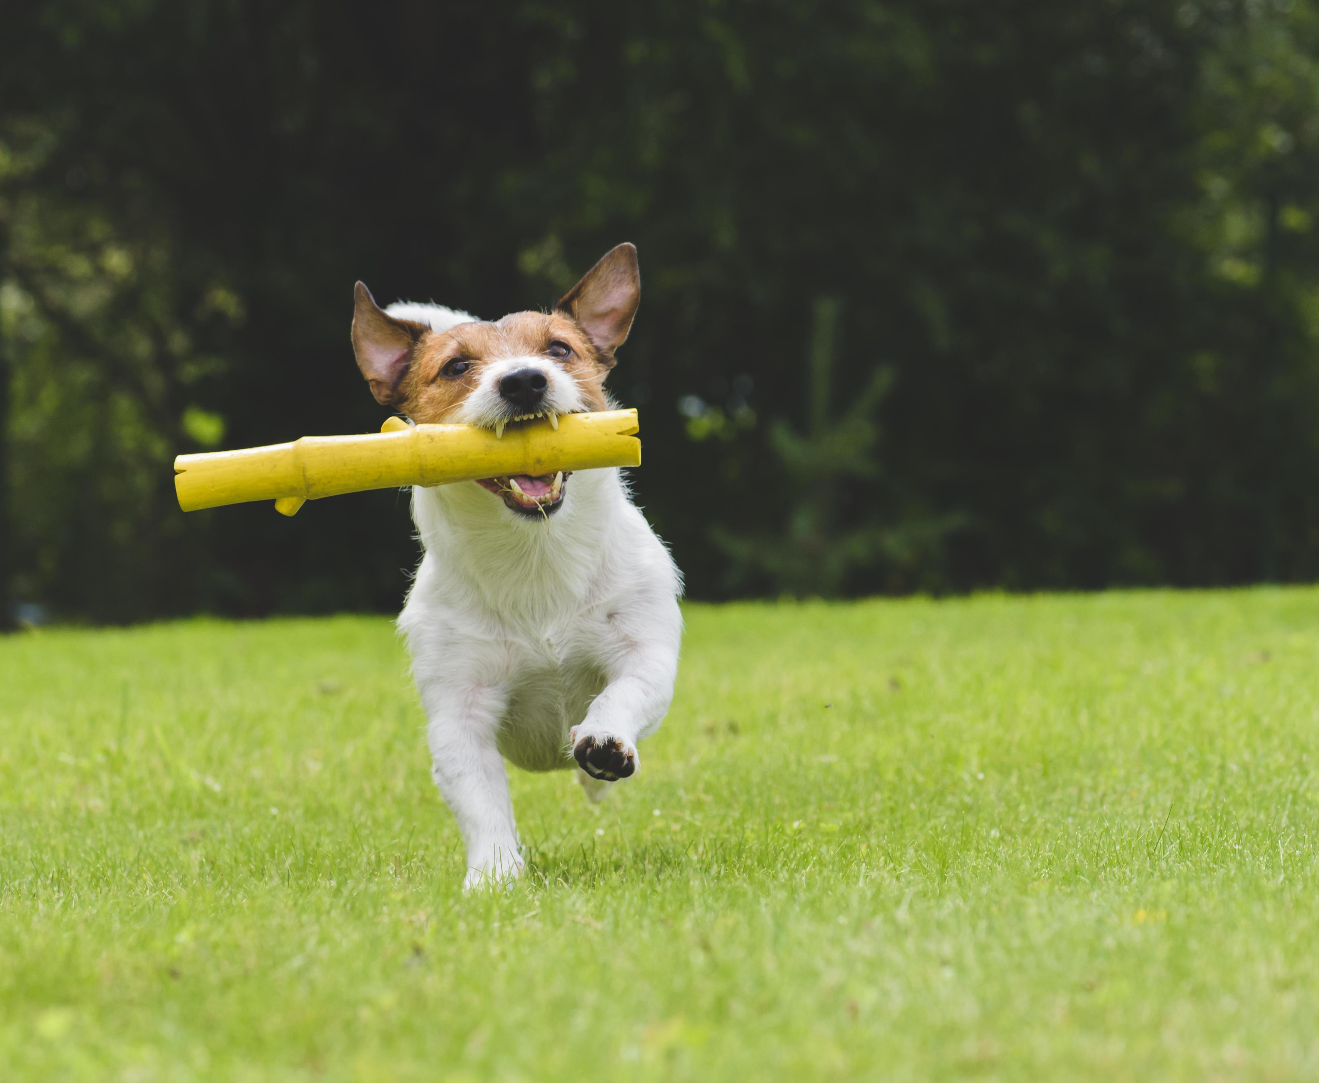
Calling a function
Notes:
Calling a function is like telling your dog to do the trick. It’s like saying “fetch!” and having your dog perform the trick.

Slide 6
Calling a Function
sayNumbers(8)
Now, in the body of the function, the num variable will be set to 8:
var num = 8;
Function name
Parentheses
Argument

Slide 7
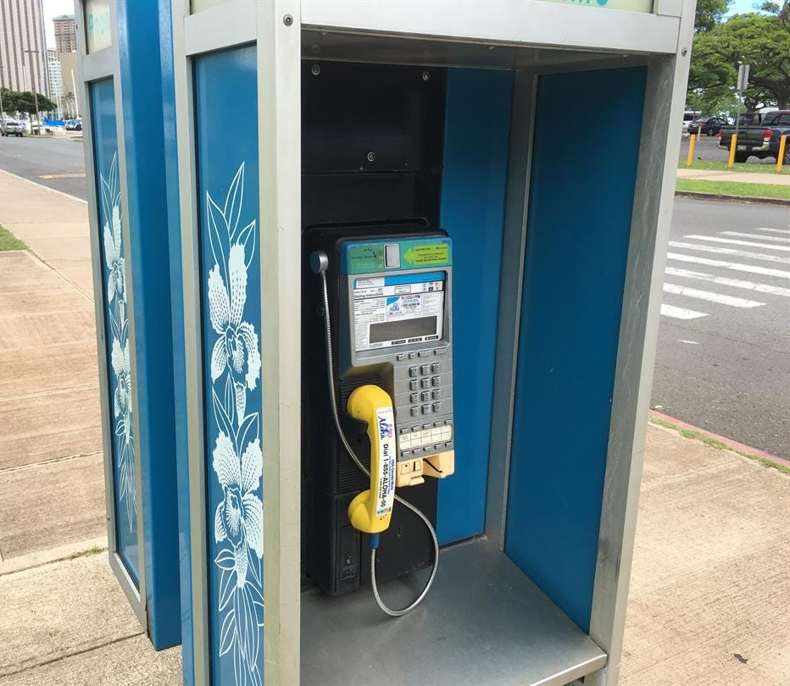
Callbacks

Slide 8
Some Background
Functions in JavaScript are objects
Just like numbers, strings, etc
Because of this, developers can use them as parameters
Any function that is passed as an argument, and subsequently called by the function that receives it, is called a callback function

Slide 9
Example – A function with a callback
function runFunction(callback) {
callback();
}
callback is a function
It is a parameter for runFunction
Notes:
The runFunction function has a parameter that is a function. In the body of the function, the callback is called.

Slide 10
Example – Using runFunction
function runFunction(callback) {
callback();
}
function sayHi() {
console.log("hi");
}
runFunction(sayHi);
What will happen?
Notes:
“hi” will be printed to the console.
Click the link to open a REPL and see the code in action.
In the REPL, add another `callback()` to the body of the `runFunction` function to see what happens!

